Slide 1
SOEN 384
Management, Measurement and Quality Control
Tutorial 2 on Quality Control
SRS Review Exercise

Slide 2
SRS review exercise overview
Objective:
  Inspect SRS Document for Quality
    Formal Technical Review (FTR) , forms were posted on Moodle
Steps:
Find Defects/Errors individually this week before the tutorial, approx.. 1h
  Record the defects in the provided Form 1
During tutorial 2, your TA will separate you in break rooms (2-3 people)
  Verify the defects found by your teammate
  Compare defect reports, eliminate those that are duplicated
  Complete a team report
  Each student will submit individual reports, team report, and team metrics by the end of the week through Moodle
Tutorial 2: SRS inspection

Slide 3
Requirements Inspection Rules
(From Sylvie Trudel’s slides)
TESTABLE :
  A requirement shall be testable by any means.
ELEMENTARY :
  Requirements shall be stated at the lowest possible level.
  A requirement shall contain only one testable item. As a guideline, if two or more things have to be tested in order to validate the requirement, then it is not expressed at the elementary level.
NEED :
  A requirement shall be stated in term of final needs, not perceived means (state the « What », not the « How »).
Tutorial 2: SRS inspection

Slide 4
Redaction guidelines for requirements
(From Sylvie Trudel’s slides)
Karl Weigers, Software Requirements, Microsoft Press, 2000
Write short sentences and paragraphs.
Do not write passive sentences.
Write complete sentences with correct grammar and punctuation.
Use consistent terminology that is defined in the glossary.
Always use the same sentence pattern : « The system shall » followed by an active verb and an observable result.
Avoid vague expressions such as « user friendly », « easy », « simple », « fast », « efficient », « superior », « robust », etc.
Avoid comparison verbs such as « optimize », « maximize », « minimize ». Instead, quantify the desired improvement level or specify a lower limit and an upper limit.
Avoid design level details such as “press button”
Tutorial 2: SRS inspection

Slide 5
Types of defects
C = Critical:
  defect that is likely to cause rework, will prevent understanding or desired functionality
M = Minor:
  information is wrong, but does not prevent understanding
S = Syntax or spelling
G = Guideline:
  agreed guideline has not been followed
I = Improvement:
  the product can stay as is but would be better with the improvement.
Q = Question:
  clarification or explanation required, often leading to a defect (critical or minor)
Tutorial 2: SRS inspection

Slide 6
Defect category to use
F = Functional defect
  Defect that may affect functionality
    E.g. missing or unclear functional requirement
N = Non-functional defect
  Defect that is not likely to affect functionality
    E.g. inconsistence in document format
U = Undetermined defect category
  Defect for which it is not obvious whether it has an impact or not on functionality
    E.g. a syntax error in a functional requirement
  Why?
    Should be categorized into F or N by consensus among participants
Tutorial 2: SRS inspection

Slide 7
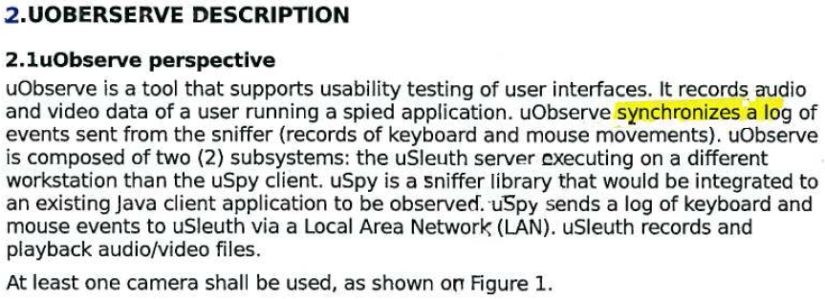
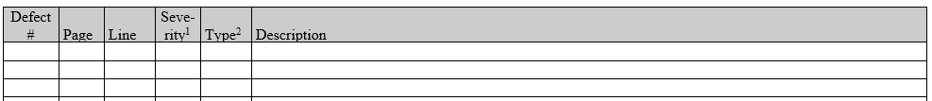
Form 1: inspection-Form1-individual.doc
(download Tutorial 2 package)
Filled up by each member of the team.
Combine them all in one file before submission.
Example:
Tutorial 2: SRS inspection

Slide 8
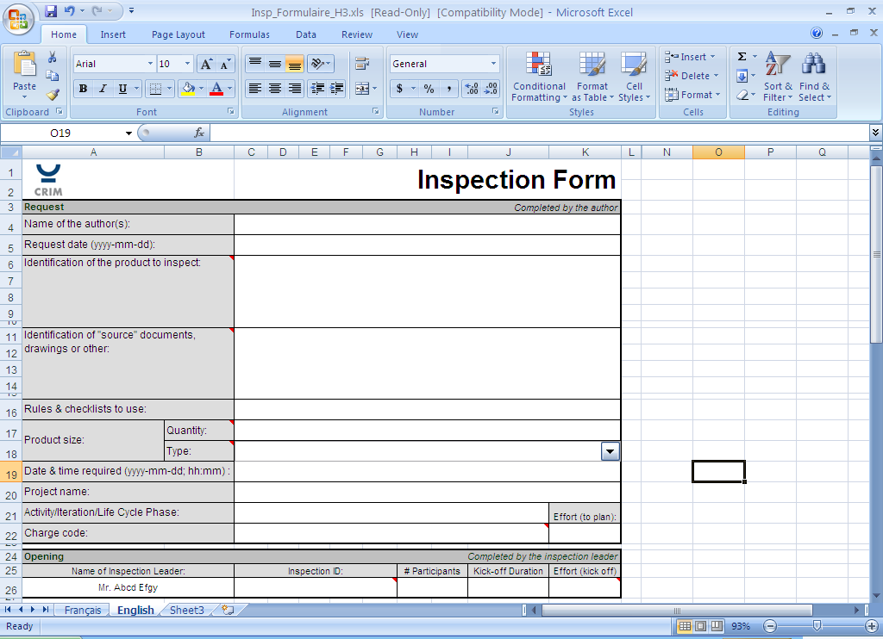
Form 2: inspection_Form2_team-leader.xlsx (download Tutorial 2 package)
Filled up by the team leader to finalize the work.
Tutorial 2: SRS inspection

Slide 9
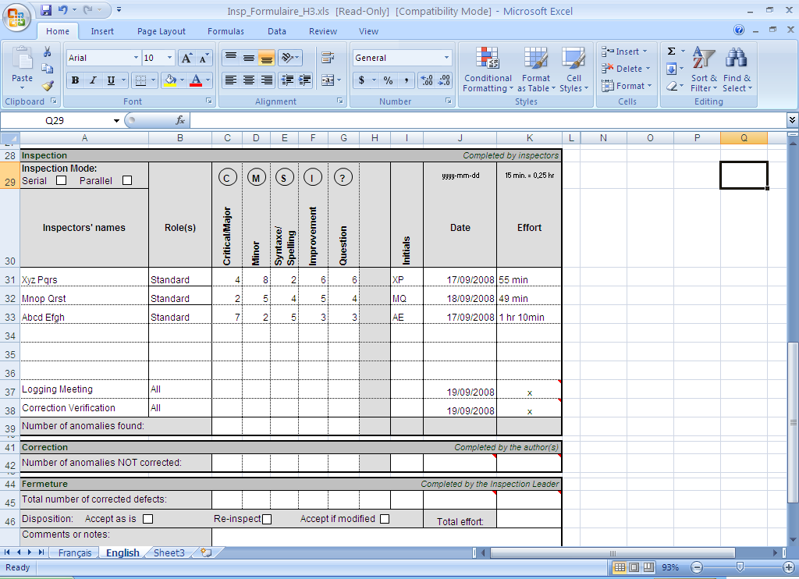
Form 2: inspection_Form2_team-leader.xlsx (download Tutorial 2 package)
Filled up by the team leader to finalize the work.
Tutorial 2: SRS inspection

Slide 10
Process for the Review and Revision of Requirements
  Inner consistency checking of all related documents
  Verifying against defined best practices (rules, checklists)
  One efficient way to provide feedback on the author’s work (Inspections and peer reviews)
  Plan for a managed-change approach
    Change traceability analysis and risk analysis
Tutorial 2: SRS inspection
Notes:
Guidelines:
Spend at least half as much time reviewing as you spend producing it

Slide 11
Review Process Metrics
Inspection Rate
This metric can be used to get a rough idea of the required duration to perform a code review. The inspection rate is the number of pages reviewer can cover per unit of time.
This rate should not be used as part of a measure of review quality, but simply to determine duration of the task.
Defect Detection Rate
This metric measures the defects found per unit of time
can be used to measure performance of the code review team, but not to be used as a quality measure.
Defect detection rate would normally increase as the inspection rate (above) decreases.
Tutorial 2: SRS inspection

Slide 12
Tutorial 2 on inspections: individual work
Goals and guidelines:
  Concentrate on Critical and Minor defects
  note any Critical defect observed
Work that must be completed before the tutorial:
  Read the SRS document
  Annotate all defects by Severity and Type
  Fill in Potential defect list (Form 1)
  Record inspection effort in minutes (Form 1)
Tutorial 2: SRS inspection

Slide 13
Tutorial 2 on inspections:
Team work
Teamwork:
  Review your team member’s defect list,
  Remove duplicate entries
  Complete inspection form for the team
  calculate Inspection Rate of your team
  calculate Defect Detection Rate of your team
  Add the metrics data to your Report
  Submit through Moodle the individual reports (Form 1), Team report (Form 2), and review metrics results

Slide 14
Remarks
If by any reason you cannot attend the tutorial live session, talk to your TA to find you a teammate for the team work

